Slide 1
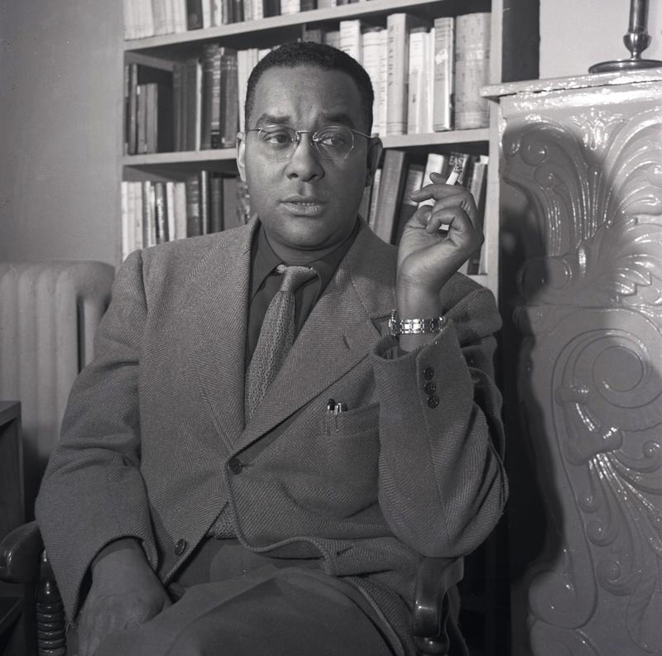
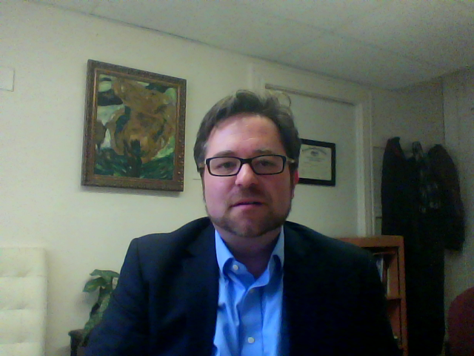
HUSB 143: Contemporary American Literature
Richard Wright, “The Man Who Was Almost a Man” (1961)

Slide 2
HUSB 143: Contemporary American Literature
Mebbe Ma will lemme buy one when she gits mah pay from ol man Hawkins.
He came in sight of Joe's store. A yellow lantern glowed on the front porch.

Slide 3
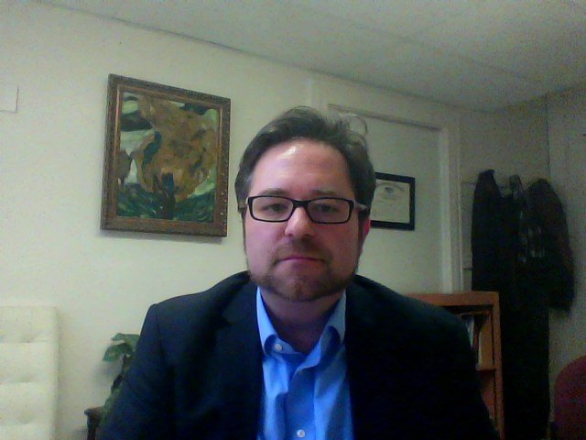
HUSB 143: Contemporary American Literature
The first movement he made the following morning was to reach under his pillow for the gun. In the gray light of dawn he held it loosely, feeling a sense of power. Could kill a man with a gun
like this. Kill anybody, black or white. And if he were holding his gun in his hand, nobody could run over him; they would have to respect him. It was a big gun, with a long barrel and a heavy
handle. He raised and lowered it in his hand, marveling at its weight.

